Slide 1


Slide 2
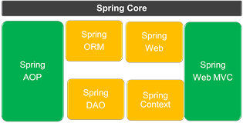
Spring Framework Architecture

Slide 3
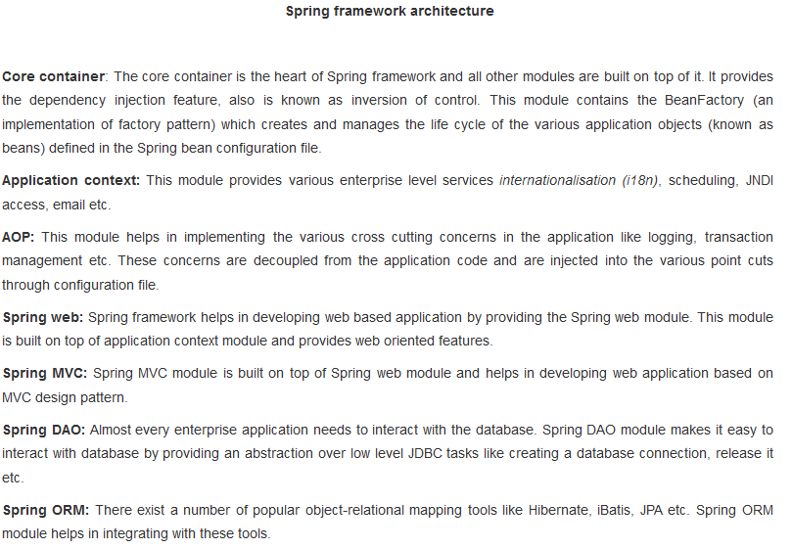

Slide 4
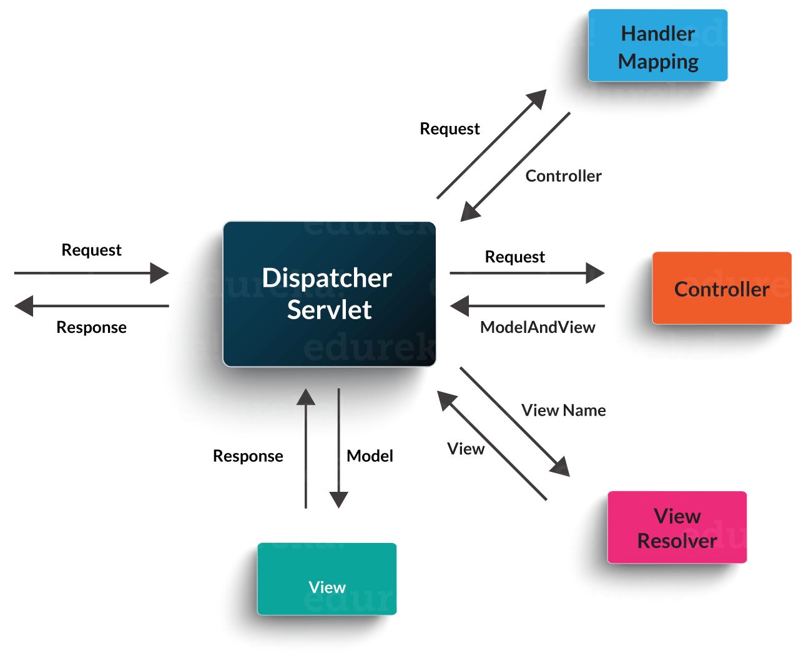
Spring MVC

Slide 5
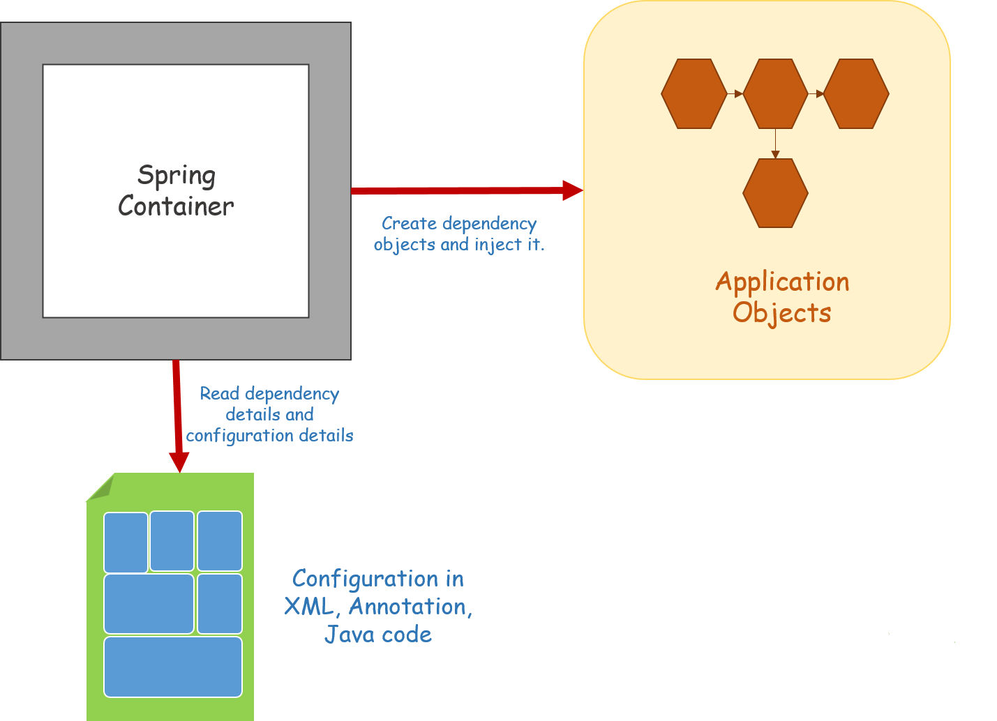
Spring – Dependency Injection

Slide 6
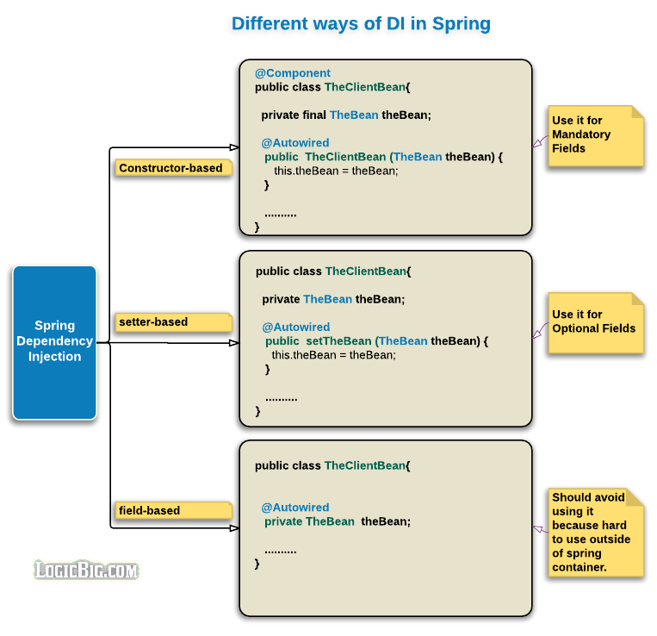
Spring – IOC Code Sample

Slide 7
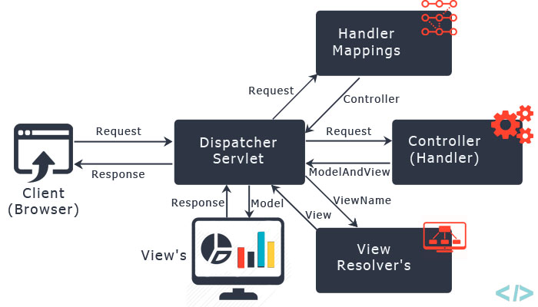

Slide 8


